Slide 1
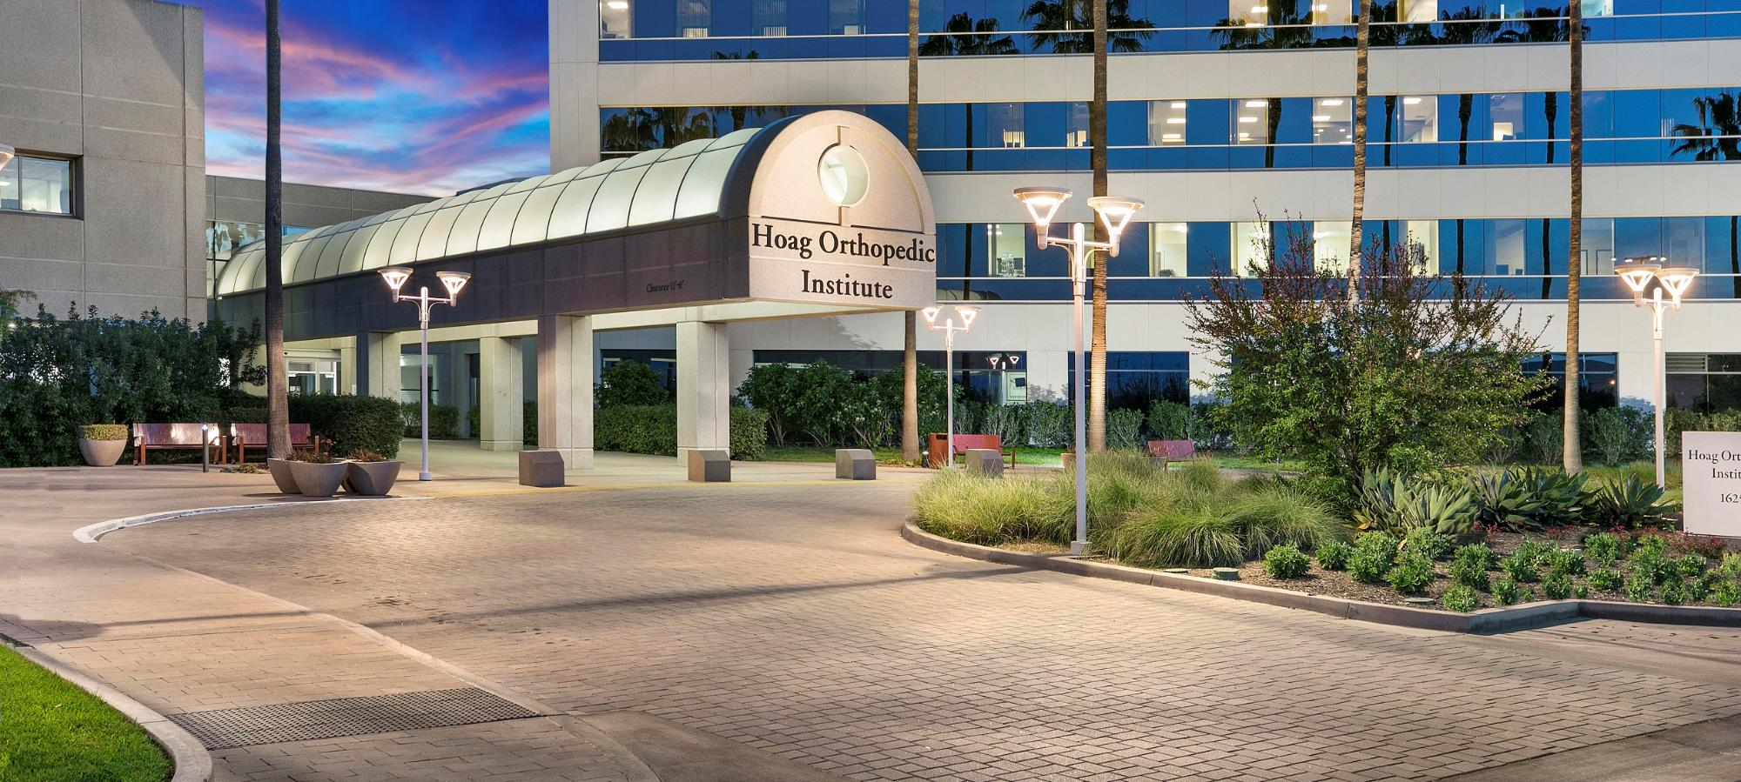
If you build it, they will come:
Coordinators as Champions for New Fellowship Programs
Vanessa Glotzbach, C-TAGME
Association of Residency Coordinators in Orthopaedic Surgery 2022

Slide 2
Disclosures ARCOS 2022
I have no conflicts of interest or relationships with commercial companies to disclose.

Slide 3
Objectives ARCOS 2022
At the end of this session, participants will be able to:
1. Navigate funding options and pathways of fellowship accreditation
2. Lead program development for a new orthopedic fellowship
3. Execute and deliver a complete proposal for a new fellowship program

Slide 4
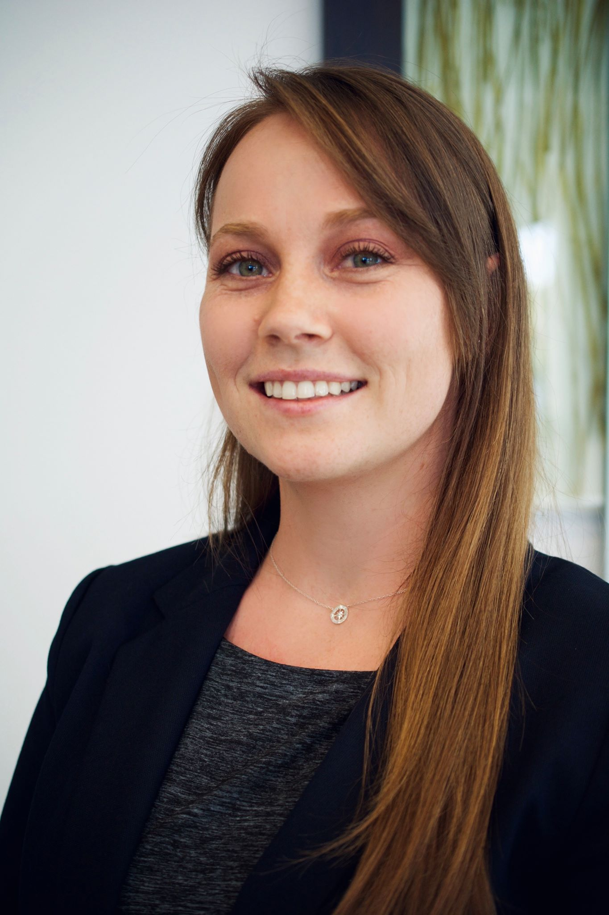
Vanessa Glotzbach, C-TAGME
Senior Programs Manager, Hoag Orthopedics
Program Director, Health Policy & Management Fellowship
Established Fellowships
Adult Reconstruction Hip & Knee
Orthopedic Spine Surgery
Ortho Sports Medicine (ACGME)
1 Health Policy & Management Fellowship
1 Foot & Ankle Fellowship

Slide 5
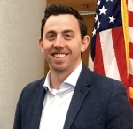
Fellowship Proposal Components ARCOS 2022
Accreditation Pathways
Building Your Program
Team of Champions
Funding Pathways
Proposal Template

Slide 6
Champion Program Coordinators ARCOS 2022
Toolbox of Skills
Intimately familiar with accreditation requirements
Interview & matching experience
Relationship building & maintenance
Administration & faculty
GME Office
Coordinators
Budgeting
Templates
CCC/PEC, Goals & Objectives, Evaluations, Rotations
Research
Excellent at using resources to find required information
ARCOS 2017 Annual Meeting - San Diego, CA

Slide 7
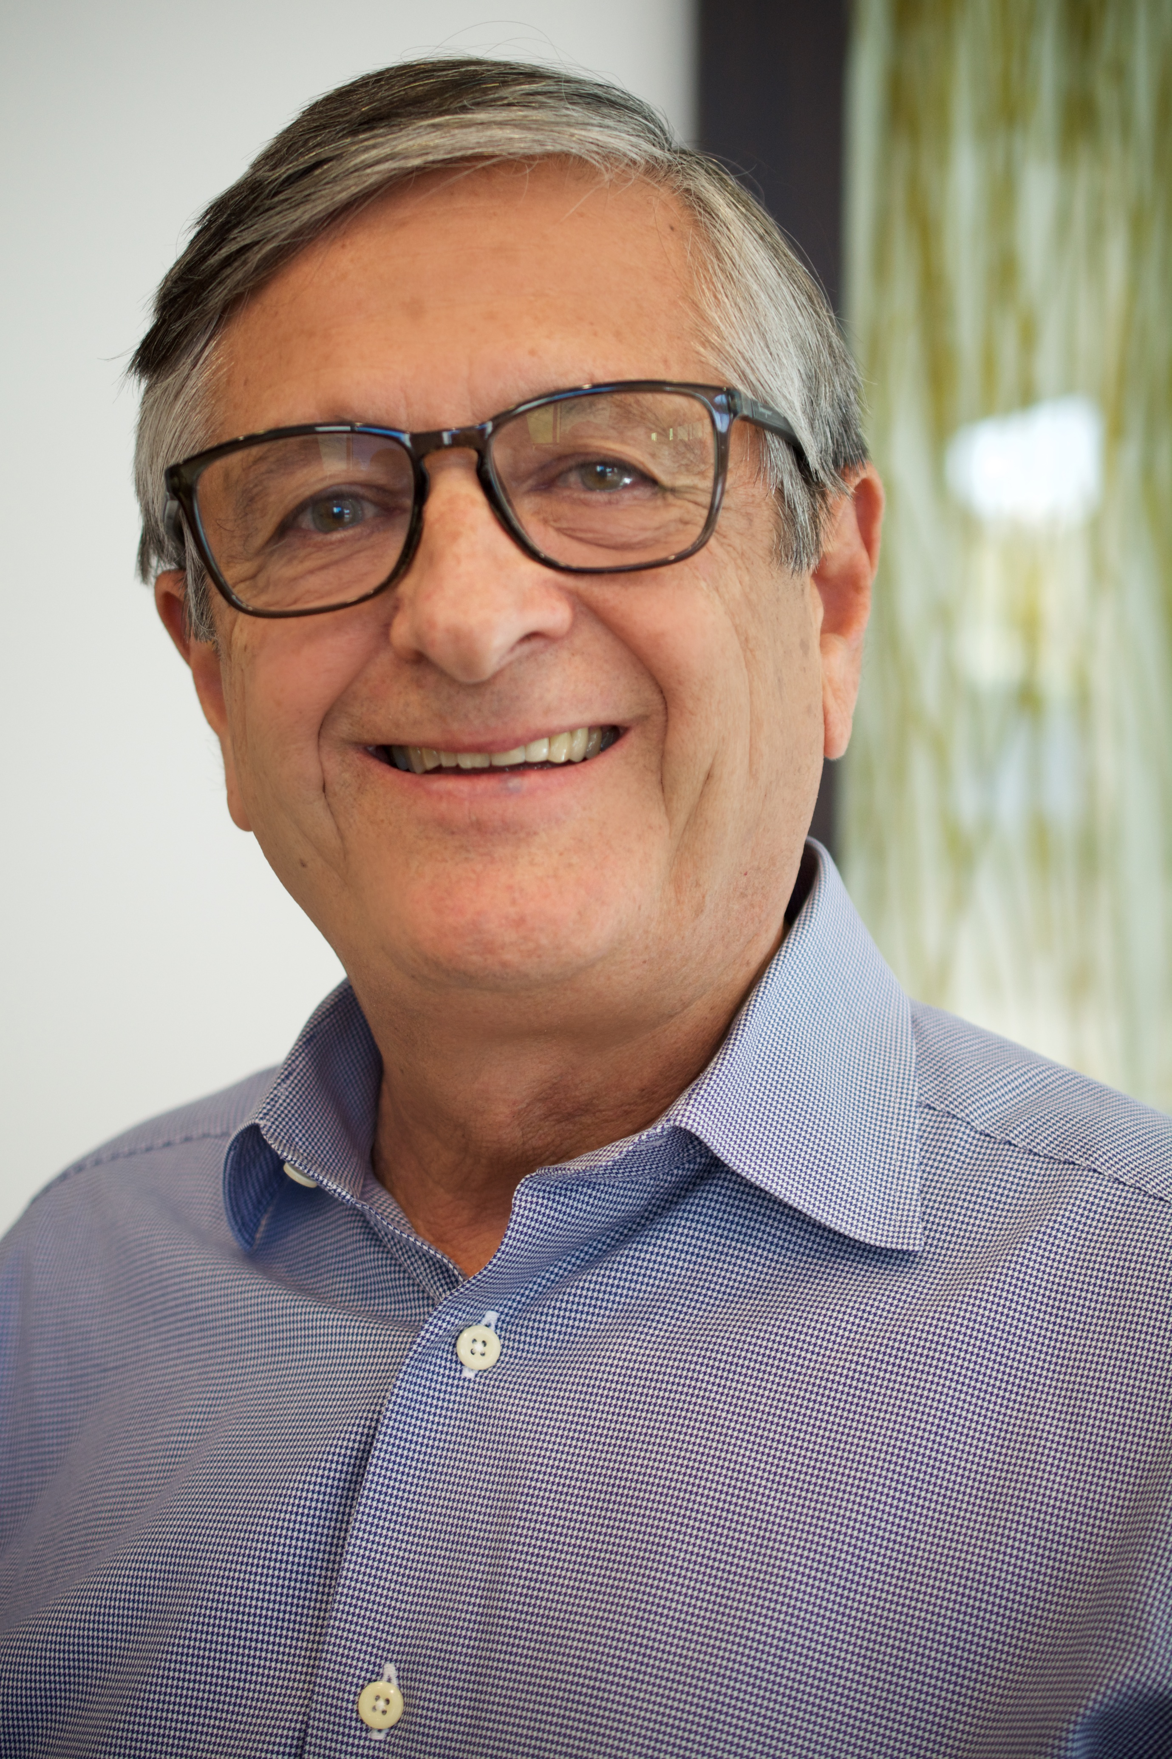
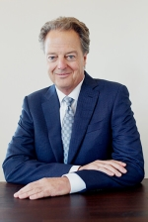
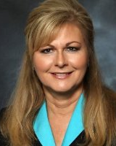
Physician & Admin Champions ARCOS 2022
Who is your champion?
What is their motivation for building a program?
Community Benefit
Altruistic
Hospital/University Initiative

Slide 8
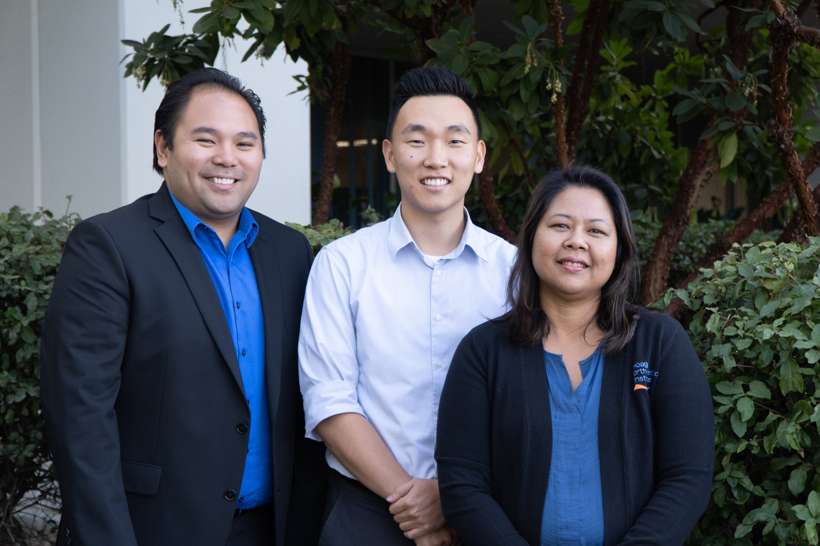
Teammates ARCOS 2022
GME Office
Sponsoring Institution
Other Faculty
Business Analytics Department
Billing Department
Mentors
Peers
ARCOS Members

Slide 9
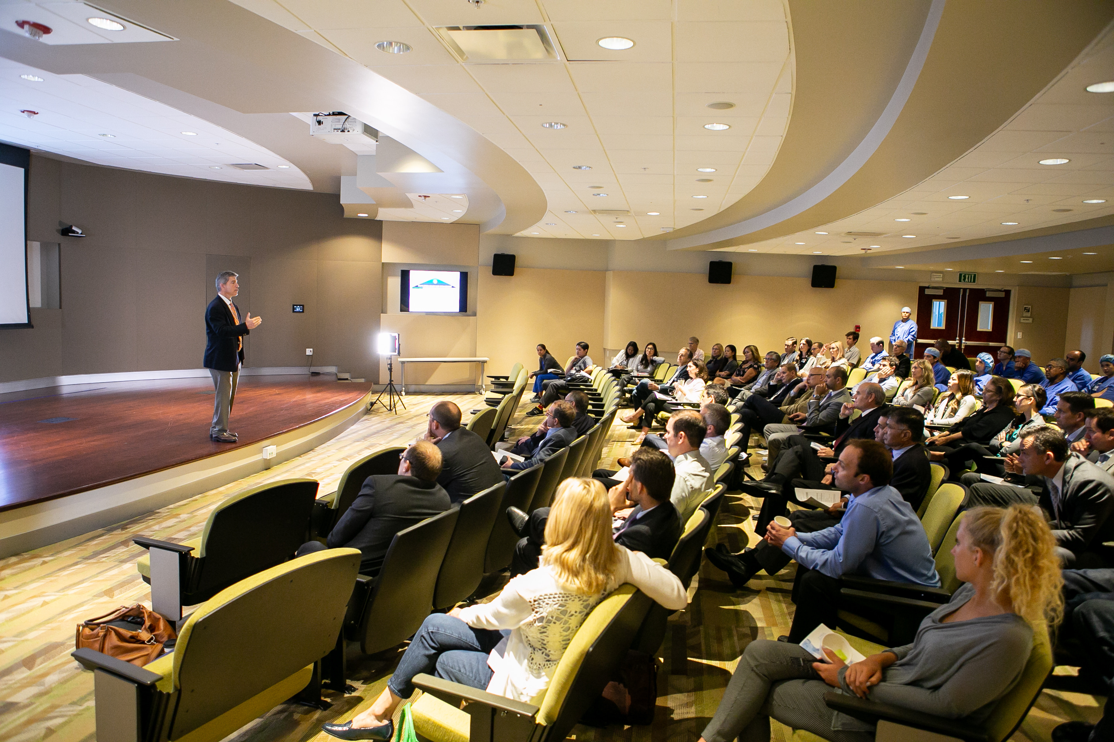
Considerations ARCOS 2022
How will this program effect/serve the community?
How will the new program financially impact the organization?
How will this program impact existing training programs?
What is special about your program?
Who is going to manage this program?
SWOT

Slide 10
Accreditation ARCOS 2022
Accreditation Pathways
The accreditation “gold standard”
Matching, Timelines, & Budgets
Notes:
Who is your champion?
Junior faculty? Established admin?
Are they settled in their role? New? Retiring?
Motivation?
Community benefit
Rural or urban populations needing more attending's
Altruism
A desire to give back to education
Hospital Initiative

Slide 11
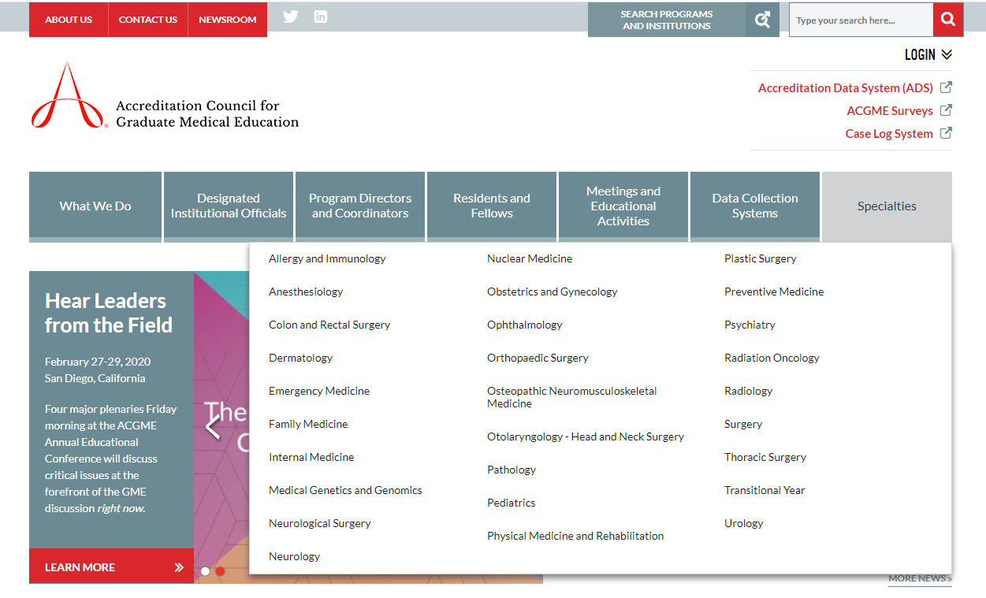
ACGME Accreditation ARCOS 2022
Source: Text
Reference: Text

Slide 12
Alternative Accreditation ARCOS 2022
Some specialty societies offer accreditation through the society as an alternative to ACGME
Source: Text
Reference: Text

Slide 13
Dual Accreditation ARCOS 2022
Some societies offer dual accreditation for programs who are ACGME accredited
and / or
Source: Text
Reference: Text

Slide 14
The Gold Standard: Subspecialty Certification
Accreditation Gold Standard ARCOS 2022
Surgery of the Hand
Orthopaedic Sports Medicine
In order to be eligible to sit for subspecialty certification, applicants must have completed a one-year ACGME accredited fellowship.

Slide 15
Unaccredited Fellowships
Unaccredited Fellowships ARCOS 2022
An unaccredited fellowship can be an option for your program if:
ACGME accreditation is not the gold standard for the subspecialty
The subspecialty society does not require having participated in an accredited fellowship to join the society as a member

Slide 16
Recruitment & Matching
Recruitment & Matching ARCOS 2022
Accreditation pathways effect match participation.
NRMP will only allow fellowships meeting the following criteria:
accredited by the ACGME or an entity acceptable to the NRMP, or
affiliated with an ACGME-accredited program in the core discipline, or
lead to certification or endorsement and oversight by a board recognized by the American Board of Medical Specialties (ABMS®).
SF Match and the Subspecialty Website list matching service eligibility in their “Code of Conduct”
Found in Specialties > Subspecialties > Overview &/or Rules section

Slide 17
Accreditation Pathways Effect Matching
Accreditation & Recruitment ARCOS 2022
Orthopaedic Subspecialty Accreditation Pathways
Specialty | ACGME | Society | Unaccredited | Match | Match Privilege
Adult Recon | X | - | X | SFM
Foot & Ankle | X | X | X | SFM
Hand | X | - | - | NRMP
Musculoskeletal Onc | X | X | X | SFM
Orthopaedic Sports Medicine | X | - | X | SFM
Orthopedic Spine Surgery | X | - | X | SFM
Orthopaedic Trauma | X | X | X | SFM
Pediatric Orthopaedic Surgery | X | X | X | SFM
Shoulder & Elbow | X | X | X | SFM* | Unaccredited ≠ SFM

Slide 18
Accreditation Timelines & Fees
Accreditation Fees ARCOS 2022
Accreditation Timeline Approximations & Fees Associated
 | Application Due Date | Decision | Application Fee | Annual Fee
ACGME | Rolling | Rolling | $6,800
5 or Fewer Trainees |  |  |  | $4,700
Greater than 5 Trainees |  |  |  | $5,700
AOFAS | June | July (same year) | None | None
ASES |  | July | $2,000 | $1,000
Dual Accreditation Available |  |  | $250
MSTS | Rolling | Rolling | None | None
OTA | January | April | $2,000 | $2,000
POSNA | July | August | $2,000 | $2,000
Dual Accreditation Available |  |  |  | $1,000

Slide 19
What to include in your budget
Proposed Budget ARCOS 2022
Fellow
Salary
Benefits
PTO
Sick Time
Health Insurance
Malpractice
Credentialing Fees
CME Conference attendance
Program
Accreditation Fees
Matching Fees
Program Director
Administration
Research
Online Library
Statistician
Journal Club
Misc.
Recruitment
Onboarding
Swag, Coats, etc.
Promotion
Celebration
Diploma, Print, Frame
Wellness

Slide 20
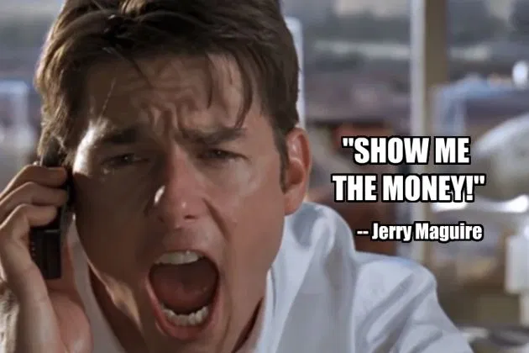
Funding Pathways
Funding Pathways ARCOS 2022
Vary based on the type of institution AND its current structure.
Partner with your administration or GMEO to understand current funding pathways for other programs (if there are any).
If you are at a private practice or non-academic institute, find allies in billing and/or analytics department

Slide 21
Funding Pathways
Funding Pathways ARCOS 2022
Is the program ACGME accredited?
YES
You cannot bill for fellow services within
the scope of their training
“double dipping”
Will the fellow be included on the Medicare Trainee Report?
YES
Remember – ACGME allows fellows to spend up to 20% of their time as a general orthopedist
Is the program ACGME accredited?
NO
You may bill for fellow services
rendered within the scope of their training
Will the fellow be included on the Medicare Trainee Report?
NO
Source: ACGME Orthopaedic 1 year Subspecialty Program Requirements Section IV.E – IV.E.1

Slide 22
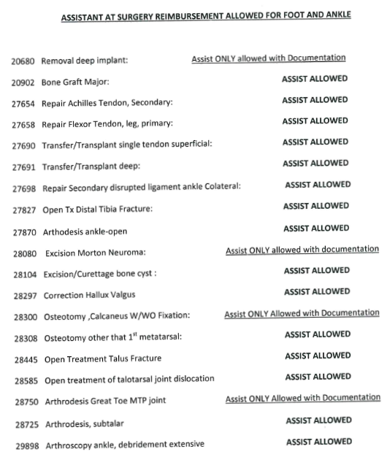
Billing
Funding Pathways - Billing ARCOS 2022
Pull the CPT coded curriculum guide from the specialty society.
Work with your PD and Billing & Analytics Departments to see how many cases & procedures the faculty performed over the previous year(s)
How many cases have an assist fee allowed?
Do they have an assist?
Did the assist get paid?
Determine if the projected case volume & its billable assist fees are enough to offset the cost of the fellowship.
A note about fellows and payors…

Slide 23
Additional Support
Funding Pathways ARCOS 2022
All programs can be supported with philanthropic dollars
All programs can be supported through grant opportunities

Slide 24
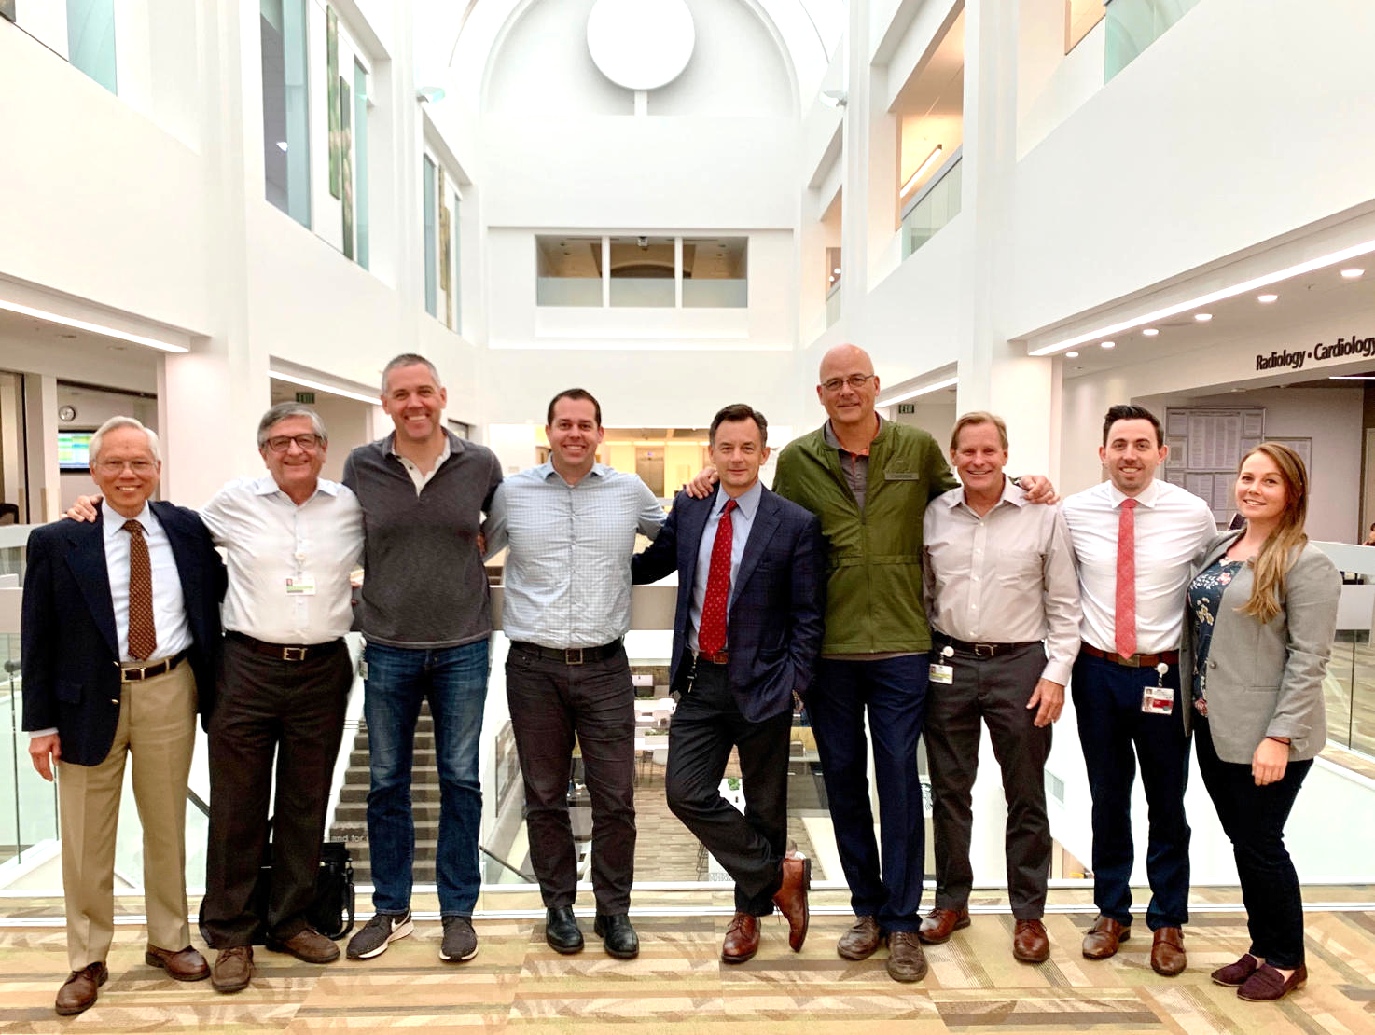
Faculty Recruitment ARCOS 2022
Who to invite?
Why are they an integral to program success?
Volume, surgical technique, patient population
How will they most be receptive to recruitment?
In person by PD/Chair
Letter/email
Both?
Program faculty collegiality
Early and often!

Slide 25
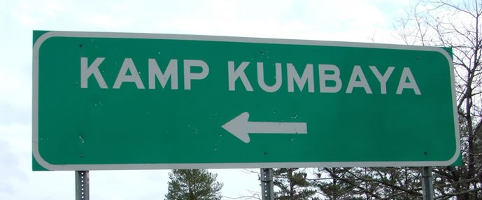
...program bonding...?
Faculty Recruitment ARCOS 2022
YES!
Hold an initial meeting
(even if everyone knows each other already)
Discuss the want for building the program
Gain insight on the kind of program each faculty member trained at
Understand why they want to be a part of a training program now?
Operate as if you are already a program

Slide 26
Program Overview – What’s on your website?
Program Overview ARCOS 2022
Goals
Case Variety & Volume
Schedule & Call
Training Room & Team Coverage
Research Requirements
Educational Conference Schedule
Application Process

Slide 27
Curriculum Foundation
Curriculum ARCOS 2022
ACGME
1 Year Common Program Requirements
Subspecialty requirements
Case log guidelines
Milestones
Specialty Society
Recommended curriculum
Fellowship program requirements
Other Resources
Connect with other programs
(or research their program websites)
Review goals & objectives for your other programs to see what is similar/different
Give the task of building curriculum to your PD & faculty, and/or task force

Slide 28
Program Details ARCOS 2022
Even if your new program is not seeking ACGME accreditation include additional documents to bolster your proposal.
1. Supervision Policy
2. Duty Hour & Moonlighting Policy
3. Sample Rotation Schedule
4. Example of evaluation(s)
 | Rotation 1 | Rotation 2 | Rotation 3
August – September | A
October – November |  | A
December - January |  |  | A
February – March | A
April – May |  | A
June - July |  |  | A

Slide 29
The Proposal ARCOS 2022
Organize to flow well
Know your audience
Use organization branding to your advantage
Be confident!

Slide 30
Proposal Template ARCOS 2022
https://tinyurl.com/ARCOS22

Slide 31
You may be in trouble if....
Considerations ARCOS 2022
Your champion is fresh out of training
Your champion is a known “Master Delegator”
Your location is saturated with similar programs
The funding/enthusiasm/support just isn’t there
Your subspecialty has more open positions than residents in the match

Slide 32
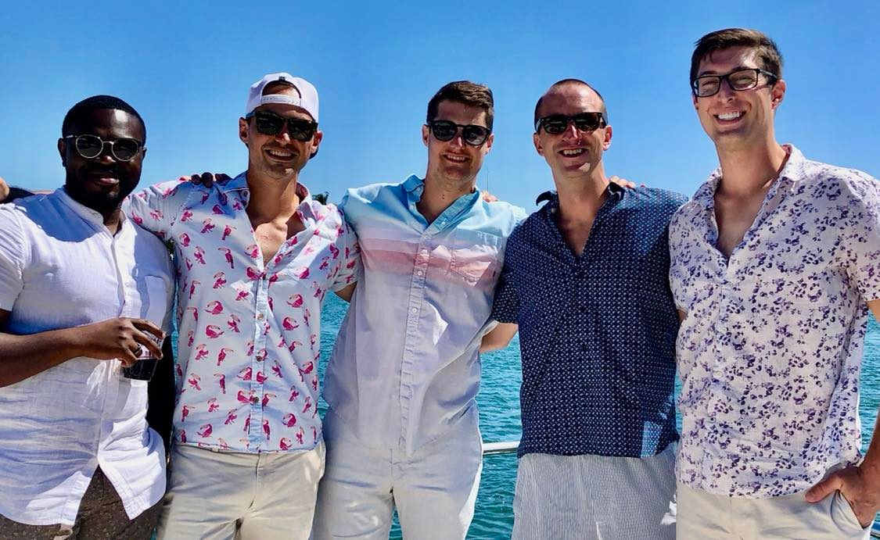

Slide 34
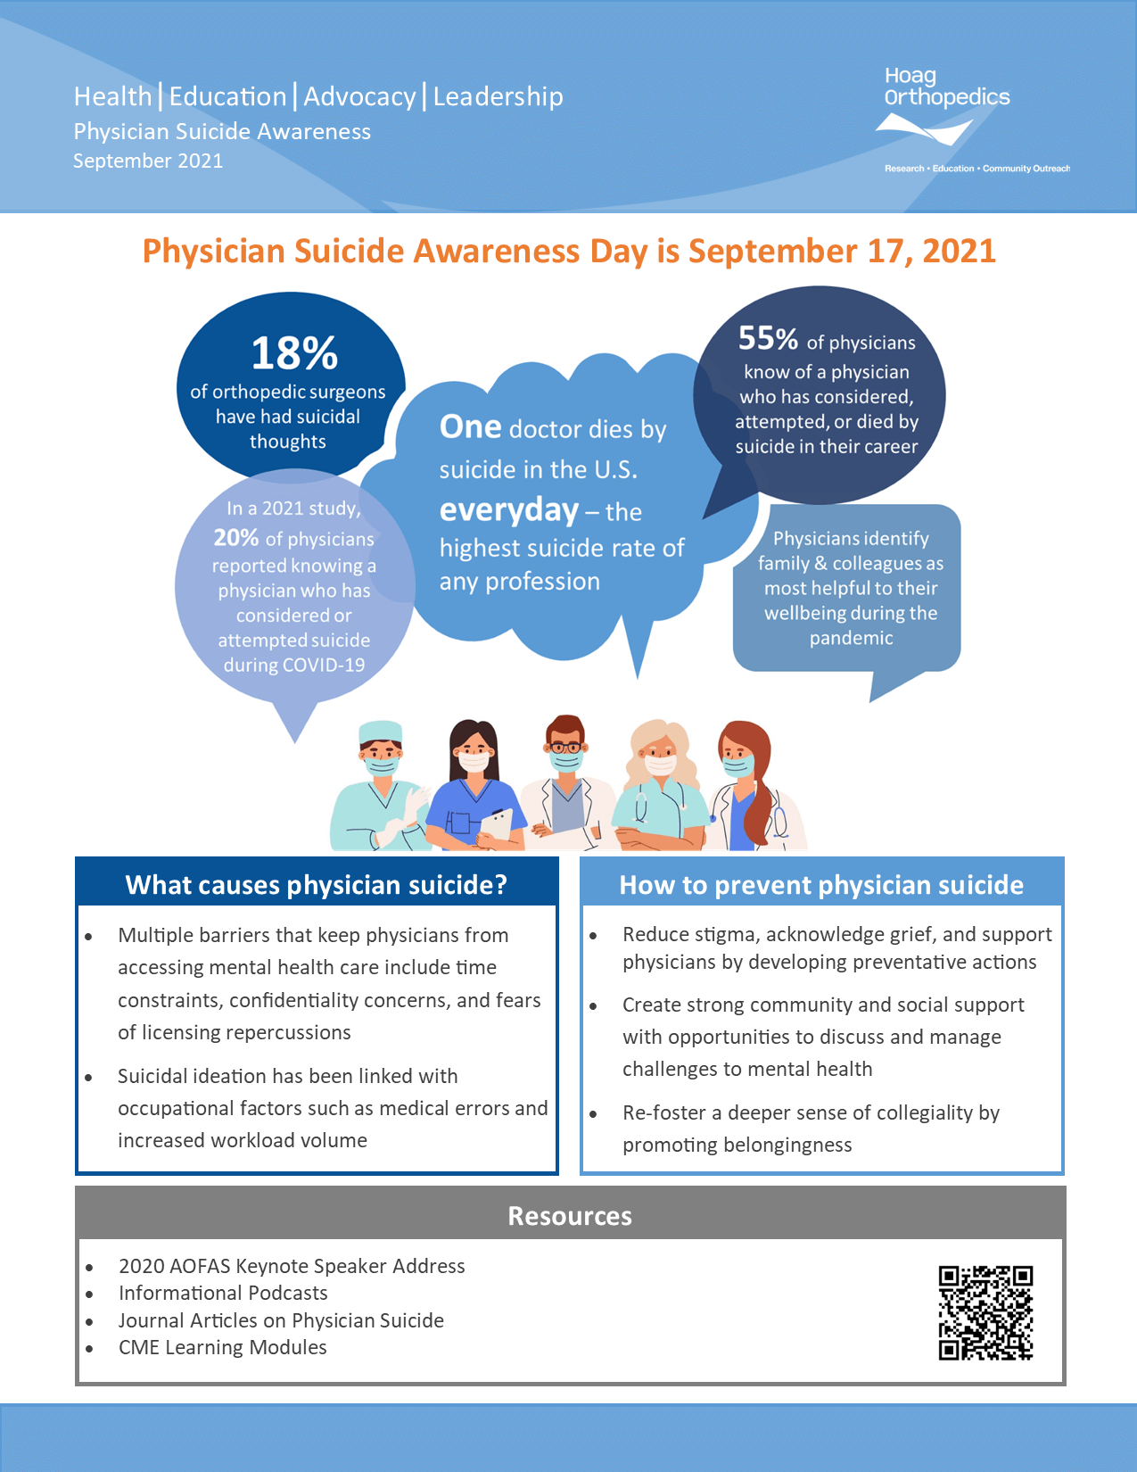
Wellness & Education
www.hoagorthopedics.org/HEAL

